Slide 1
AUTONOMOUS DRIVING AID
VINAYAK RANJANAGI

Slide 2
INTRODUCTION
What is autonomous driving system? An autonomous car is a vehicle capable of sensing its environment and operating without human involvement.
This can be used to automate the operation of motor vehicles
Our model is trained with images of the real world environment to make judgement calls at critical times
The functionality of the vehicles’ operations can be varied according to the scope of the aiding system

Slide 3
SCOPE
Autonomous driving is everywhere and the technology supporting it is only advancing.
The future of transportation is Autonomously driven vehicles, which can assist in a wide range of functions, still conforming to the norms of traffic.
Energy Efficiency: Optimize driving patterns to conserve energy and enhance sustainability in autonomous vehicles.
Continuous Learning: Employ mechanisms for continual model improvement through feedback loops and updates.

Slide 4
OBJECTIVE
Developing Safe Autonomy: Create an AI system that ensures safety while achieving autonomous driving capabilities.
Enhancing Road Safety: Reduce accidents by deploying a reliable autonomous driving model with advanced perception.
Improving Traffic Efficiency: Optimize traffic flow and reduce congestion through efficient autonomous driving systems.
Minimizing Human Errors: Mitigate risks associated with human driving by employing robust machine learning algorithms.

Slide 5
CHALLENGES
Finding a suitable model
Finding a usable framework
Improving accuracy - The accuracy has to be maintained, as inaccurate readings might be damaging
Training model - The model is trained on custom dataset, and also should be trained on real life data, which is more important

Slide 6
APPLICATIONS
Ride-Hailing Services: Implementing autonomous vehicles for ride-sharing platforms, offering on-demand transportation.
Goods Delivery: Enabling autonomous vehicles for efficient and cost-effective last-mile delivery services.
Public Transportation: Integrating autonomous buses or shuttles for safer and more reliable public transit.
Personal Commuting: Providing individuals with self-driving cars for daily commuting needs.
Senior Care & Assistance: Providing autonomous vehicles for elderly care and transportation services.

Slide 7
LITERATURE REVIEW
We have referred to the Learning a Deep ConvNet for Multi-label Classification with Partial Labels paper for this.
They have taken a partial label approach, while we have adapted the rest of the methods for a complete image label approach
Aside from this paper, we have also used the following we sources for the implementation of this project:
GitHub
YouTube

Slide 8
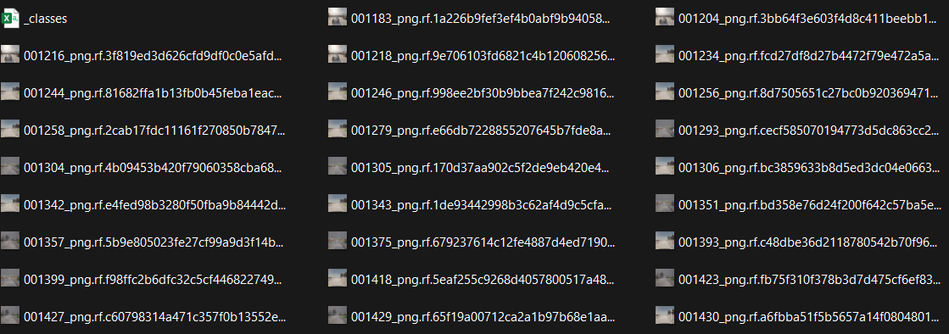
DATASET
The CARLA Software is a simulation software which is used to train autonomous driving models. They also have an extensive set of images to train the images on.
This allows use to use the images with a ‘_classes’ file, which has the specific classes related to the dataset.

Slide 9
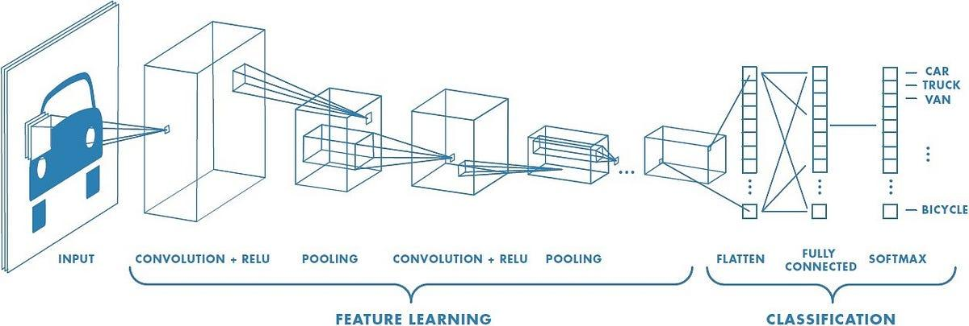
Convolutional neural networks

Slide 10
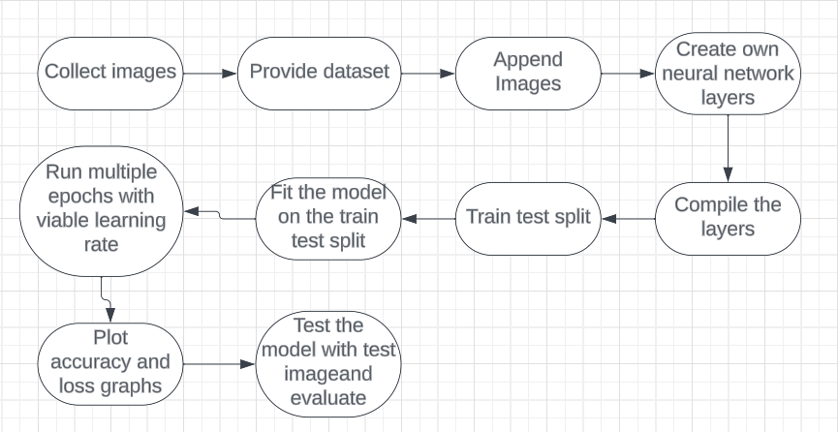
Block Diagram

Slide 11
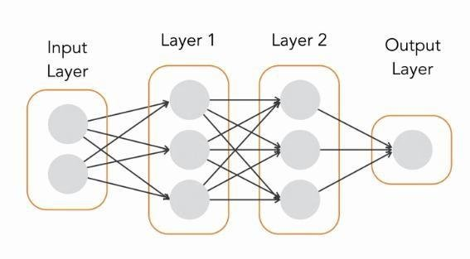
Model Used
Sequential: Linear stack of layers
Conv2D, MaxPooling2D, Dense, Dropout, Flatten, and BatchNormalization

Slide 12
BENCHMARK VALUE
The final accuracy value of the model is given in the final lines of code itself.
Working with convolution layers is tricky, and the initial first model testing accuracy was around ~21%
Finally, we set our benchmark accuracy value to be >45%
Our model currently gives an accuracy of 51-52%

Slide 13
Individual Contributions and Results
Vishal V: Finding dataset, literature review, online guides
Anselm Baretto: Convolutional layer definition
Vinayak Ranjanagi: Errors and accuracy
Sai Akshitha: Model used

Slide 14
CONCLUSION and FUTURE WORK
We have successfully made a model while defining our own neural layers.
This has allowed us to create an ML model which detects obstacles on road.
In conclusion, the obtained accuracy rate of 52% reflects a significant milestone in our efforts to develop an autonomous driving model using the provided dataset. While this accuracy demonstrates notable progress, there remains ample room for improvement. This achievement signifies a foundational step in our pursuit of refining and enhancing the model's capabilities.
Our future goal is to create a fully functioning autonomous driving system.

Slide 15
REFERENCES
https://openaccess.thecvf.com/content_CVPR_2019/papers/Durand_Learning_a_Deep_ConvNet_for_Multi-Label_Classification_With_Partial_Labels_CVPR_2019_paper.pdf
https://github.com/bnsreenu/python_for_microscopists/blob/master/142-multi_label_classification.py
https://www.youtube.com/watch?v=hraKTseOuJA

